Slide 1

ChronoForge: The AI Attention System
Defend your attention. Engineer your routine.

Slide 2

The Cognitive Black Hole
Unstructured Time
Notification Hijack
Planning Assumption
Time between lectures becomes a trap without structure.
Devices meant for work become sources of distraction.
Existing tools assume perfect metacognitive skills.

Slide 3
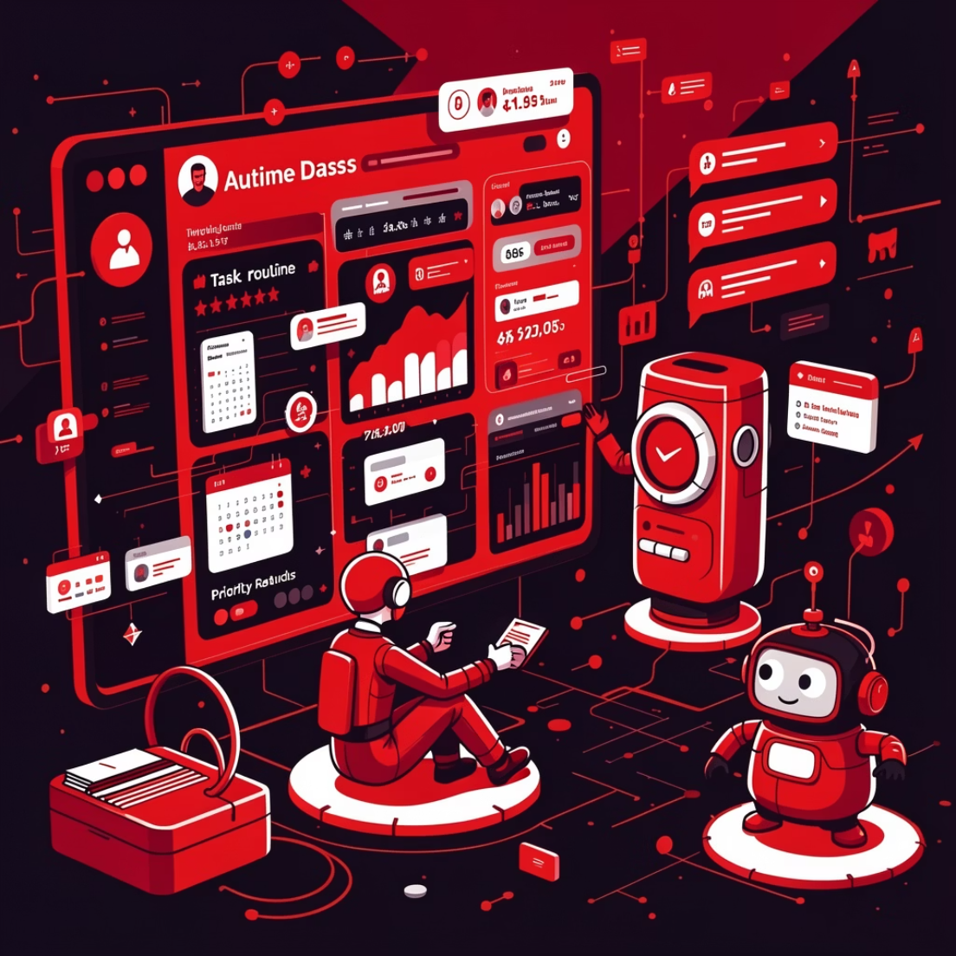
A Systemic Defense Mechanism
AI-Driven Routine Orchestrator
Generates opinionated, priority-aware routines everyday.
Dynamic Reshuffling
Adapts instantly to schedule changes throughout the day.
Screenless Deep Focus
Disappears completely when serious work begins.

Slide 4

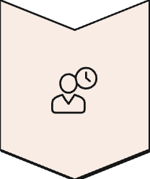

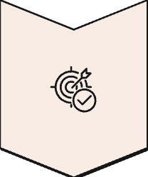

Intelligent Orchestration
Timetable
Deadlines
Calendar
Goals
Performance
Five sources of truth converge to produce an optimized daily plan.
Strategic Truancy Engine
Dynamic Gap Routing
Calculates safe lecture skips using 75% attendance mathematics.
Fills 1-2 hour voids automatically with goal-aligned tasks.

Slide 5
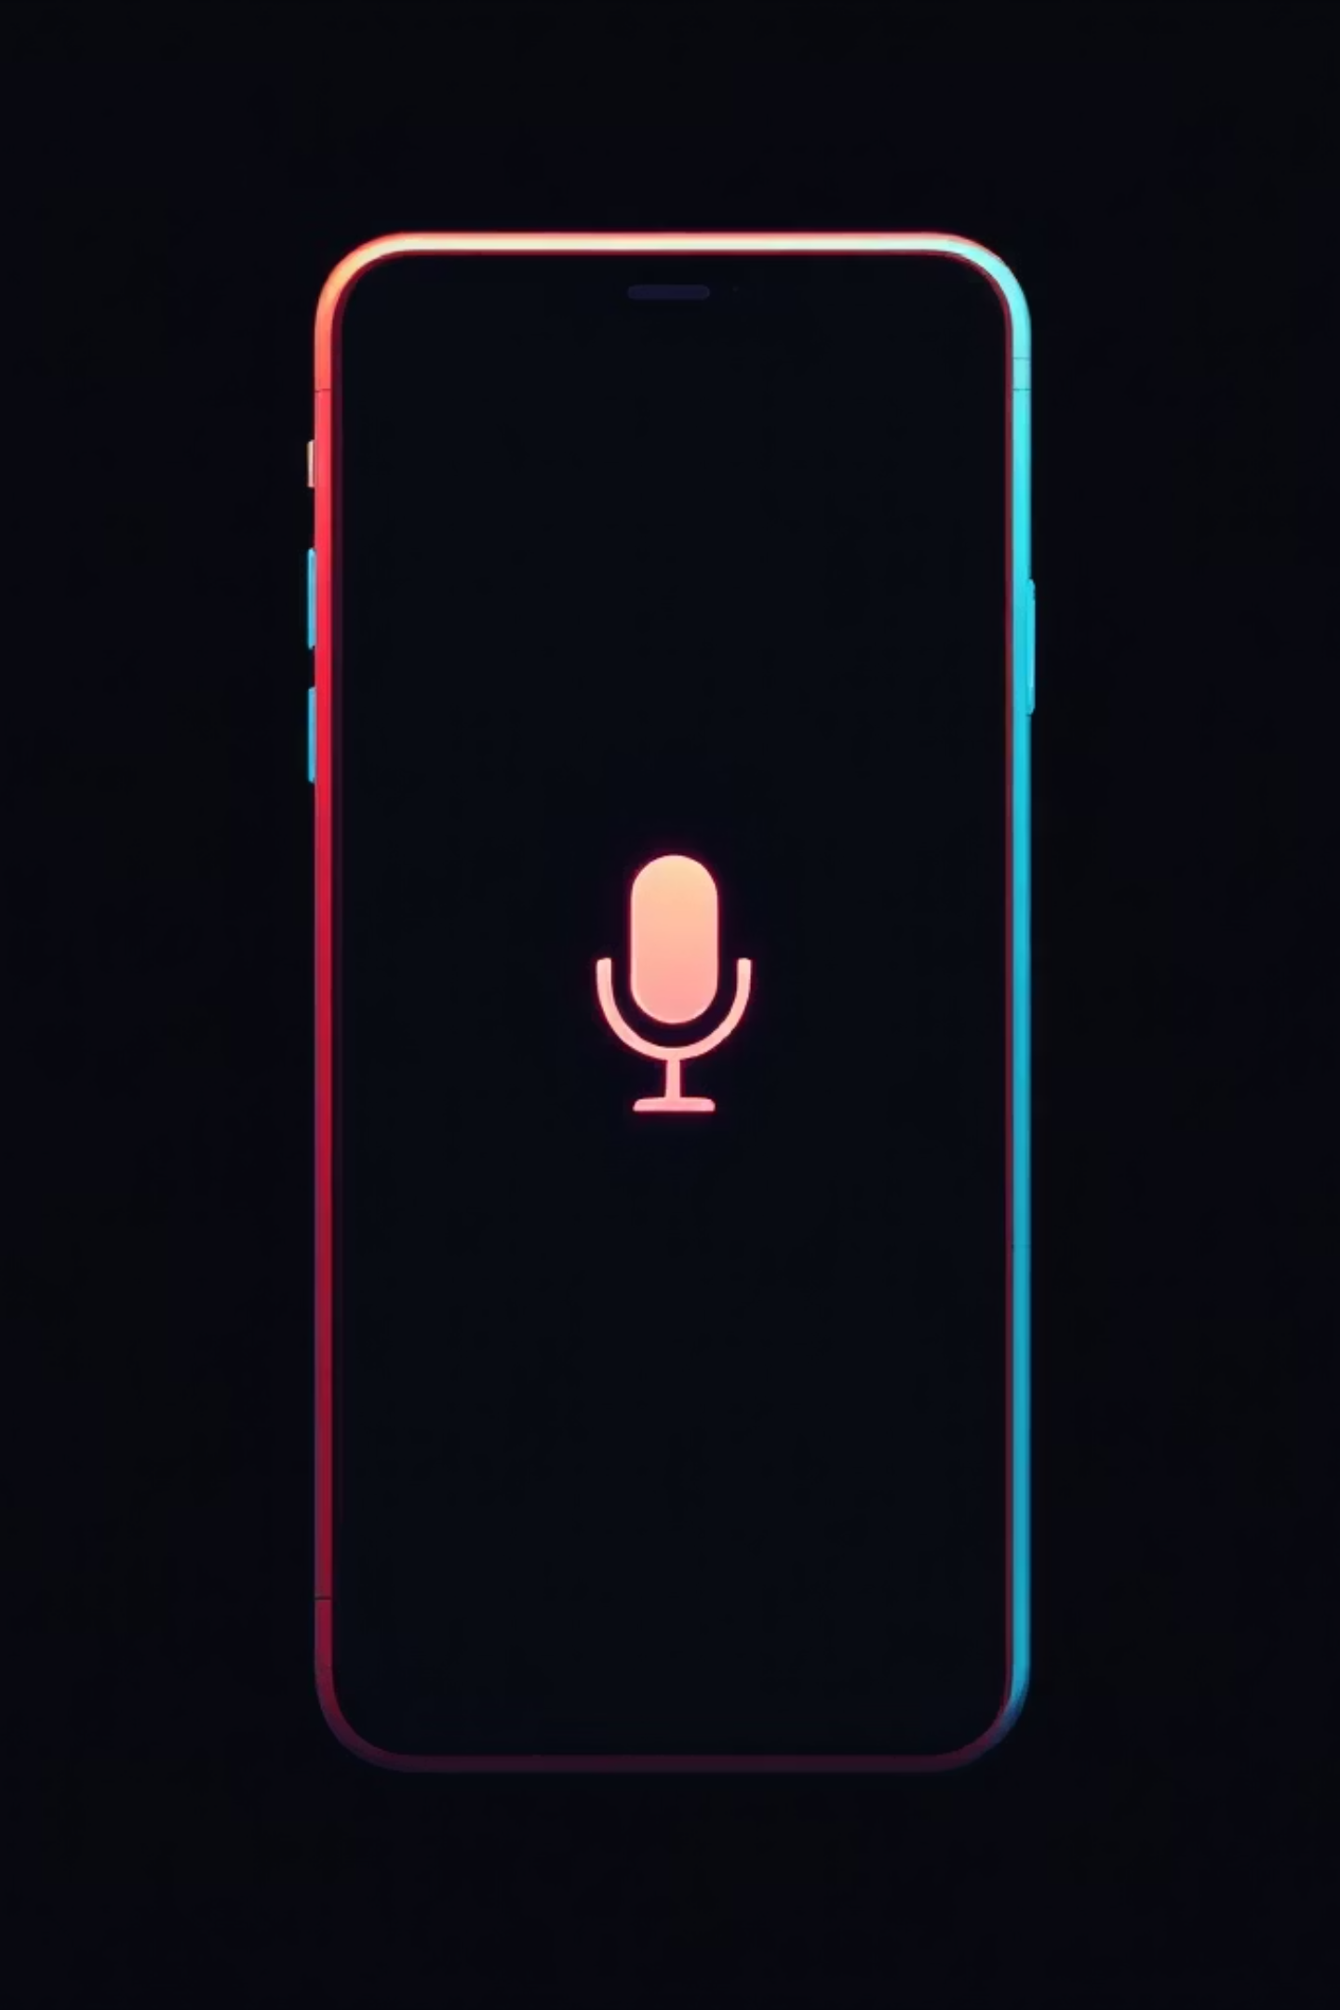
Screenless Execution
Screenless Deep Focus
Voice-Wake
Visual notifications locked during work sessions.
Query critical updates via local vector database using voice.

Slide 6

EchoStake: Shared Focus, Shared Success
Amplify Focus Through Peer Accountability
Mutual Commitment
Real-time Synchronization
Each member stakes a portion of their daily "focus points," reinforcing commitment.
Seamlessly sync focus blocks with peers, ensuring everyone is on the same page.
Shared Success
Achieve collective milestones and celebrate together, fostering a positive feedback loop.

Slide 7

Demo Time
Watch ChronoForge transform your workflow.

Slide 9
Initialize Deep Focus
Stop negotiating with distractions.
Engineer your routine.

Slide 10
Thank You
College isn't short on time. It's short on attention.
Let ChronoForge defend your attention at the system level.

